Slide 1
FDA304 Pitch.
Sam Cox.

Slide 2
Basic Concept.
2D Isometric Shooter.
Unity 2D.
Set in a city at night-time.

Slide 3
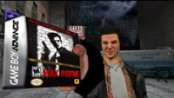

Game Inspiration.

Slide 4
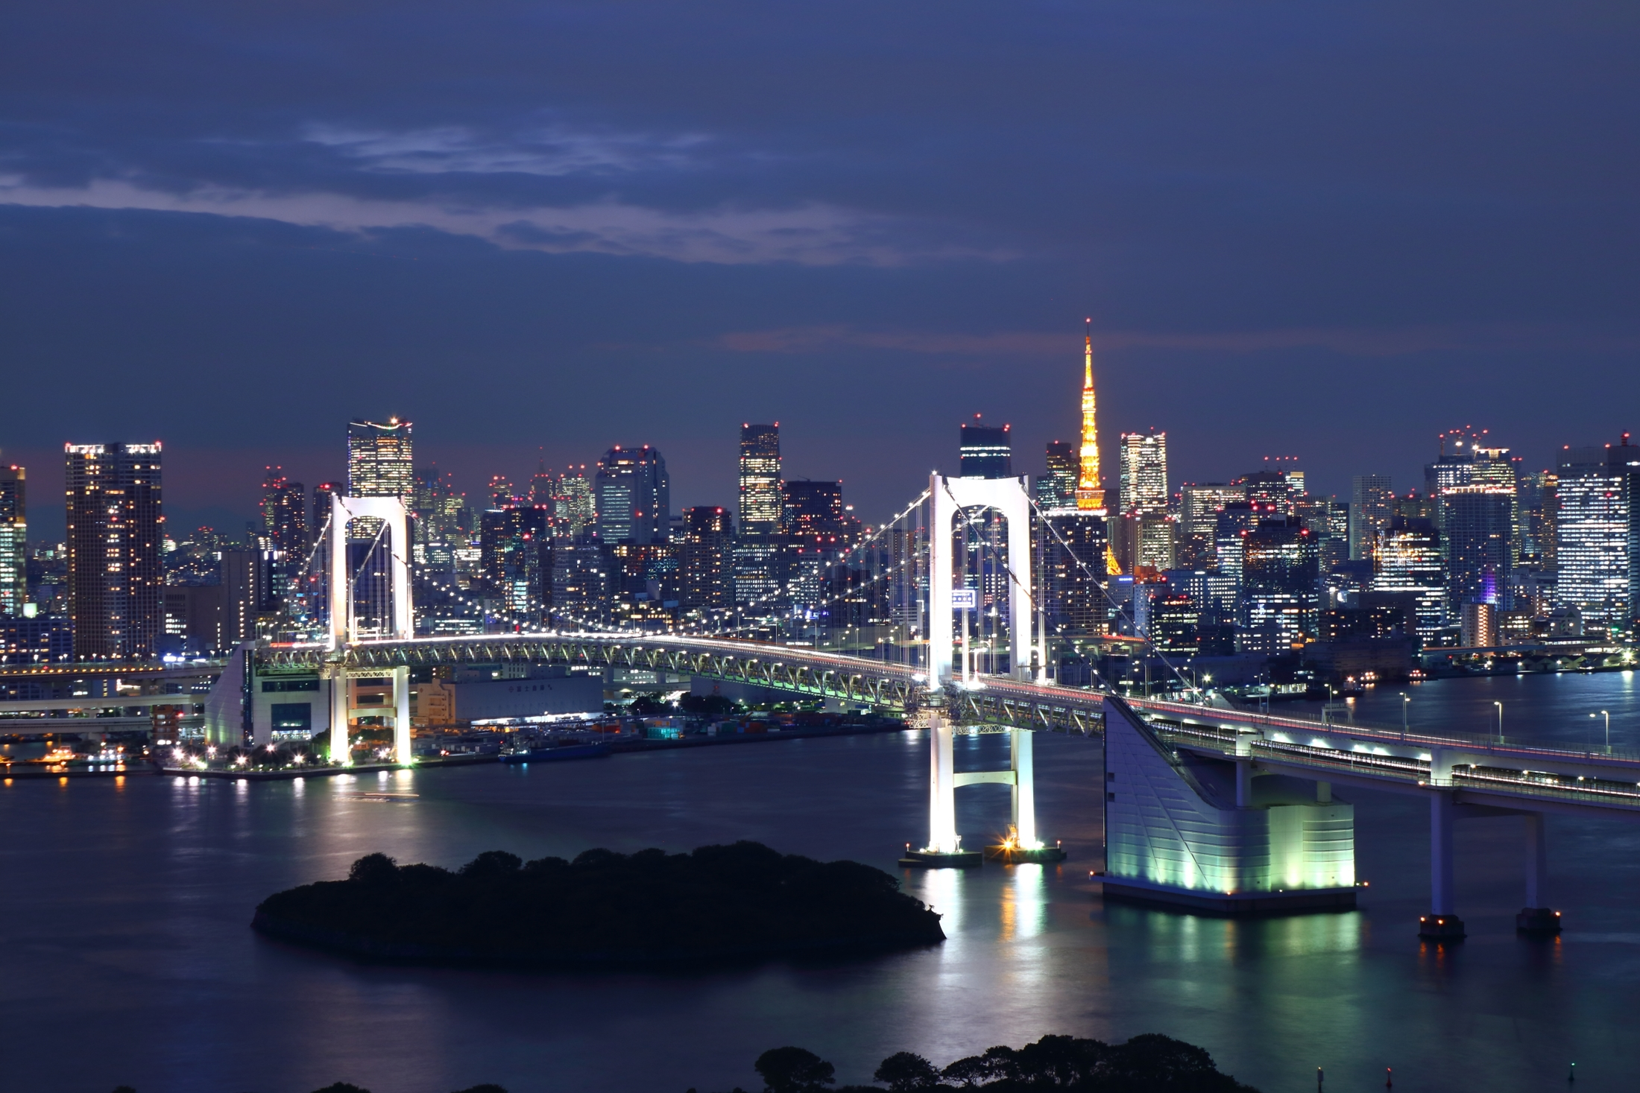
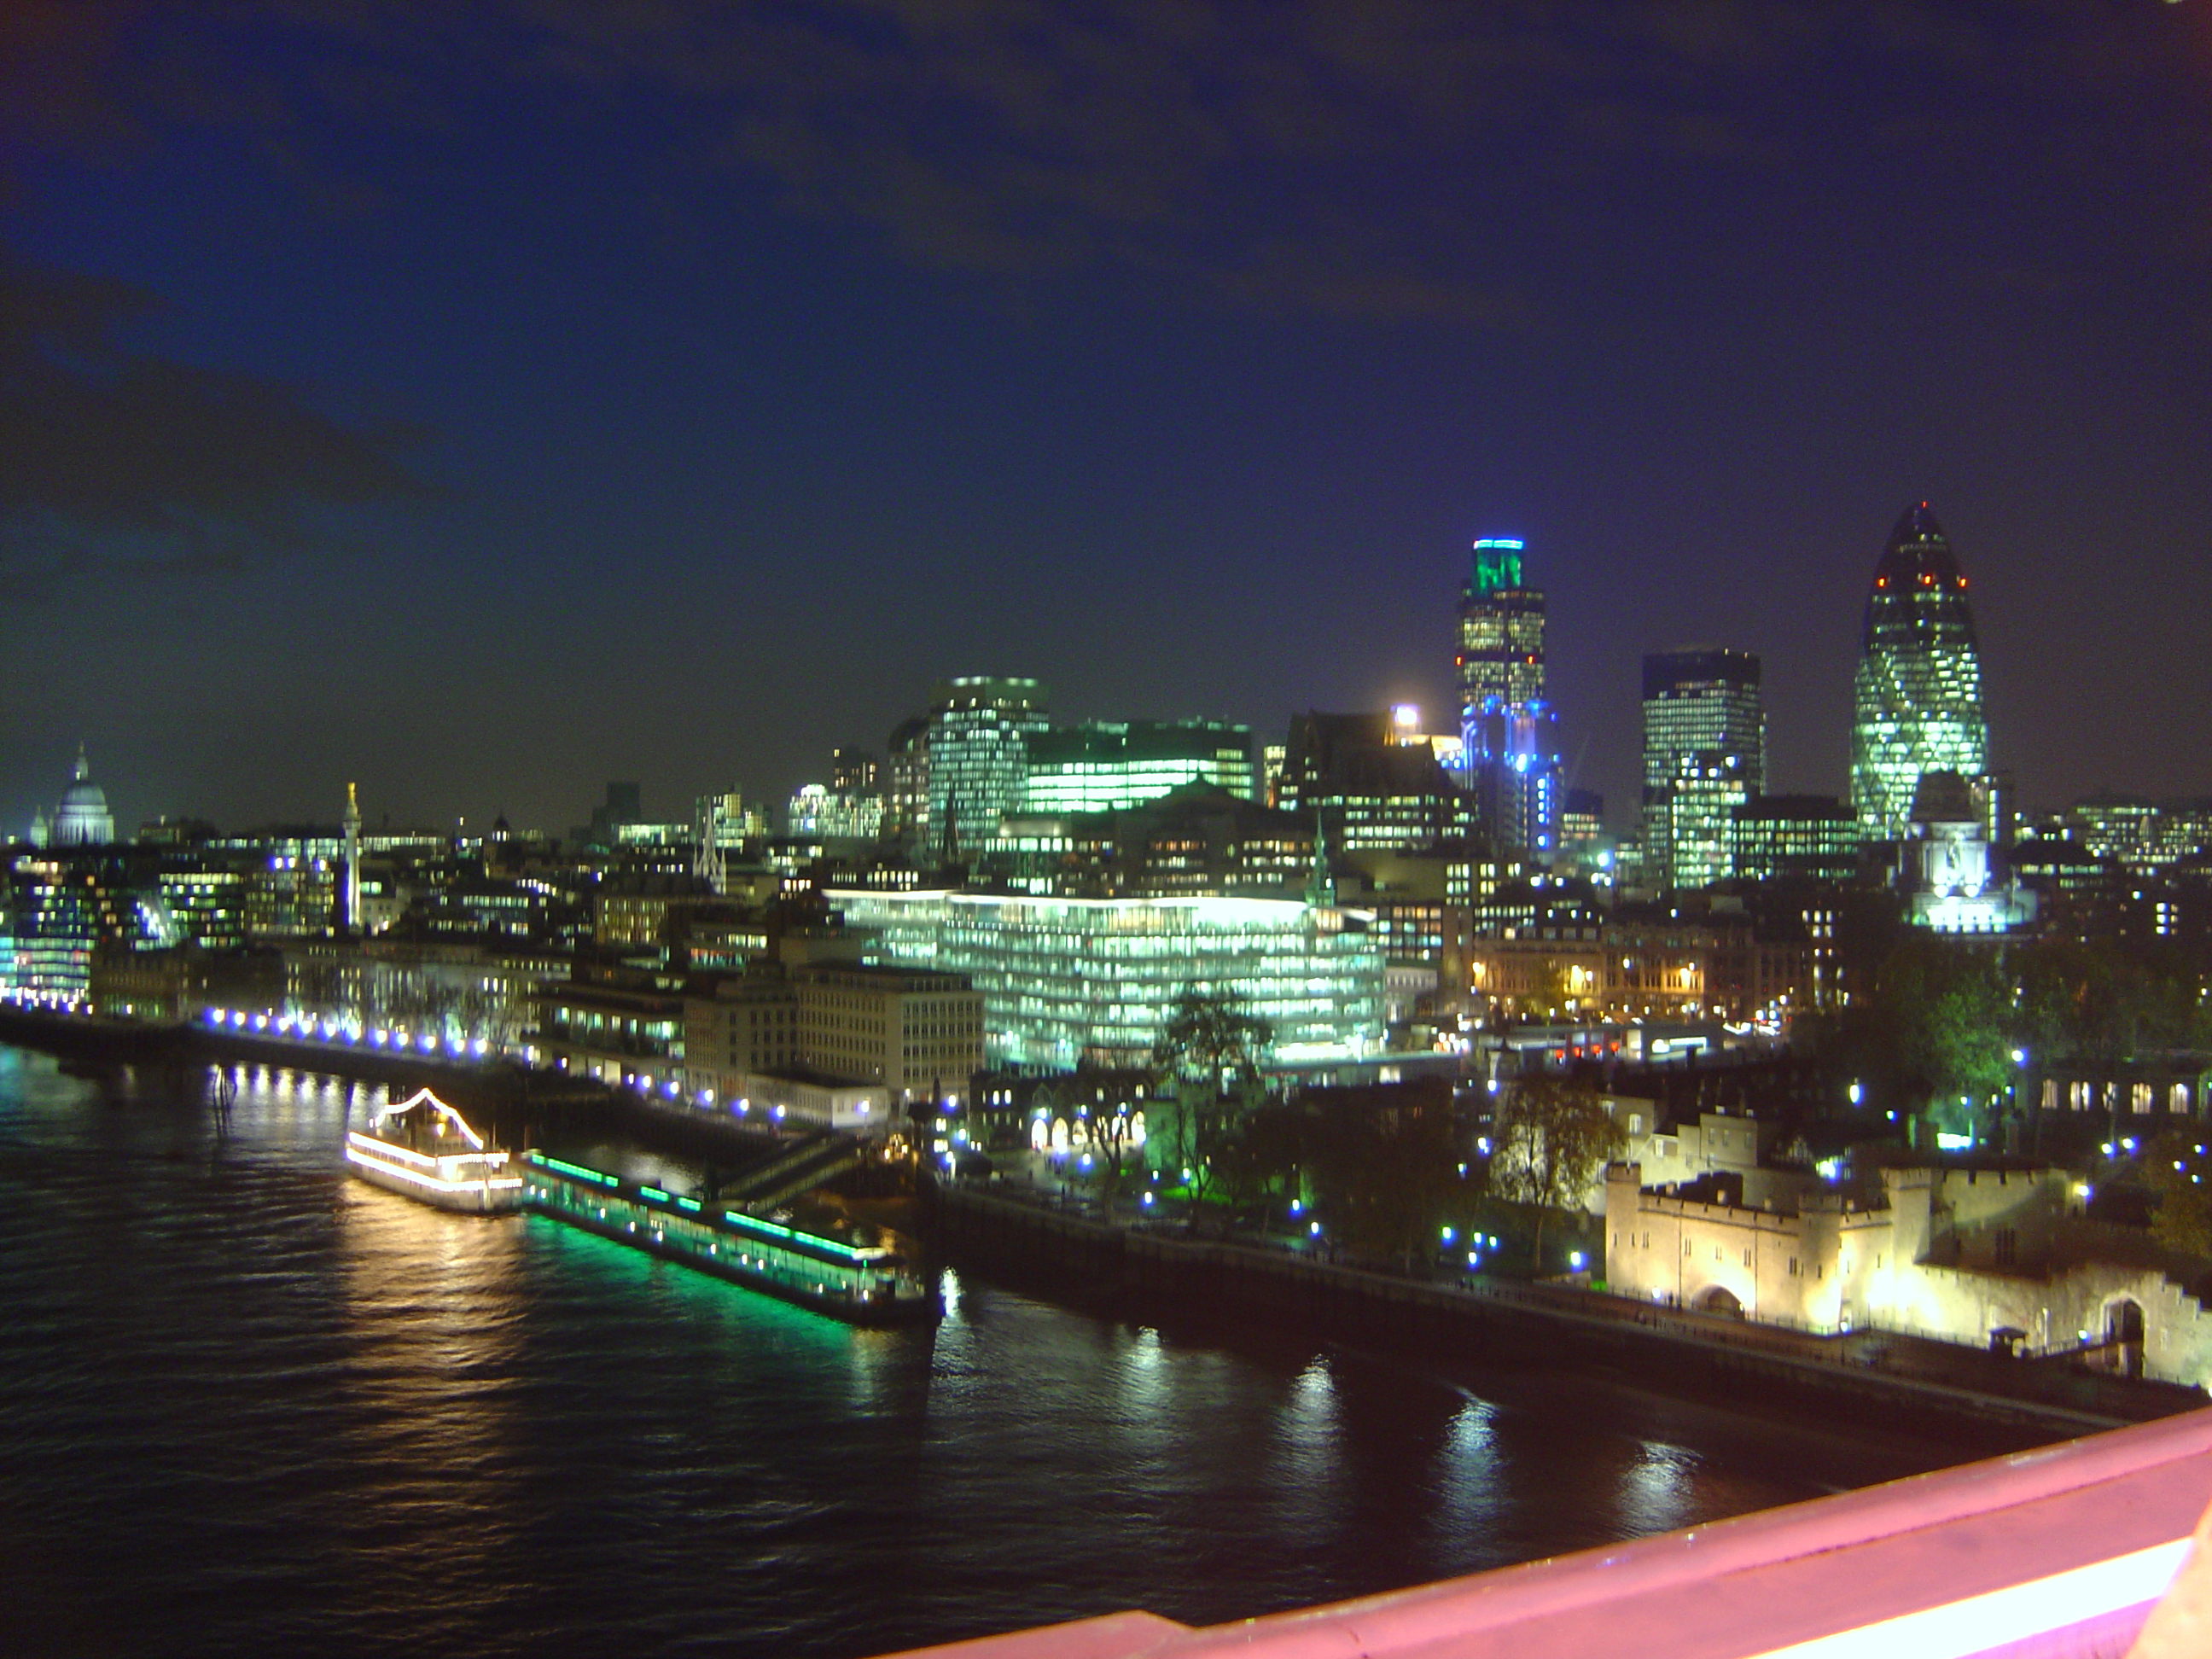
Art Inspiration.
City of London at night.jpg. (2005, December 21). Wikimedia Commons. https://commons.wikimedia.org/wiki/File:City_of_London_at_night.jpg
Rainbow Bridge (Tokyo) at night 10.jpg. (2016, November 3). Wikimedia Commons. https://commons.wikimedia.org/wiki/File:Rainbow_Bridge_%28Tokyo%29_at_night_10.jpg

Slide 5
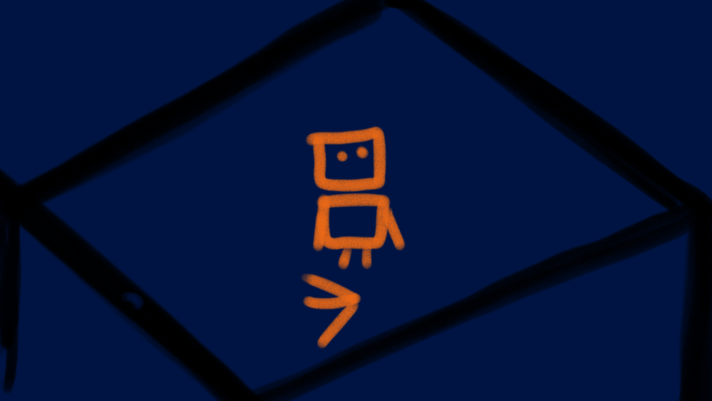
Concept Art.

Slide 6
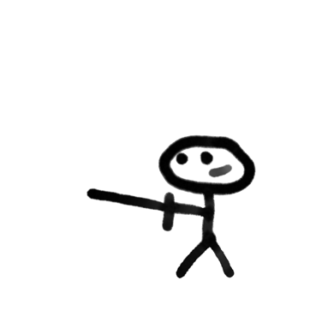
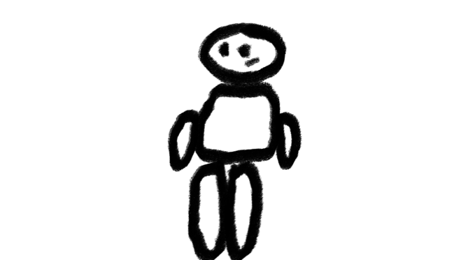
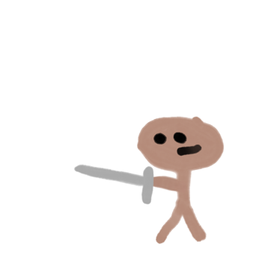
Character Iteration.

Slide 7
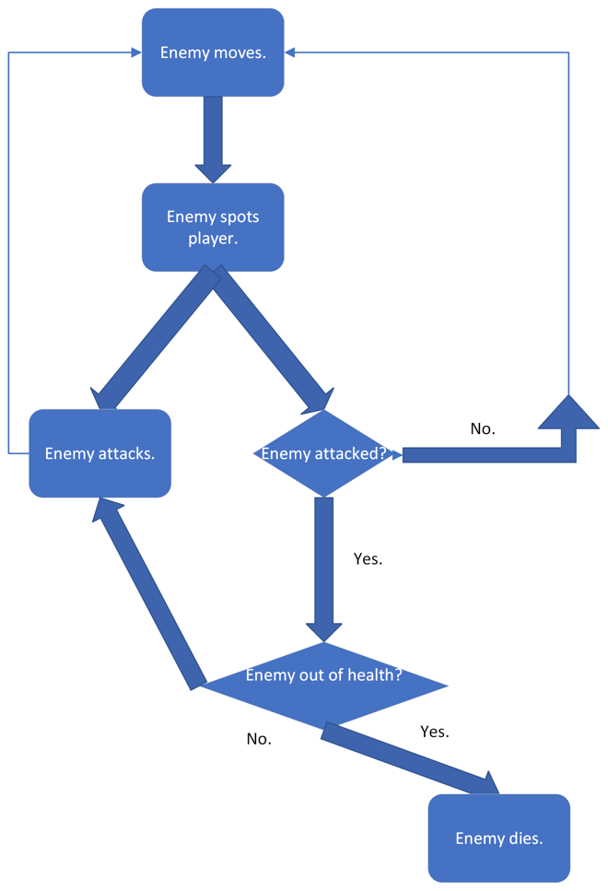

Flowcharts.

Slide 8
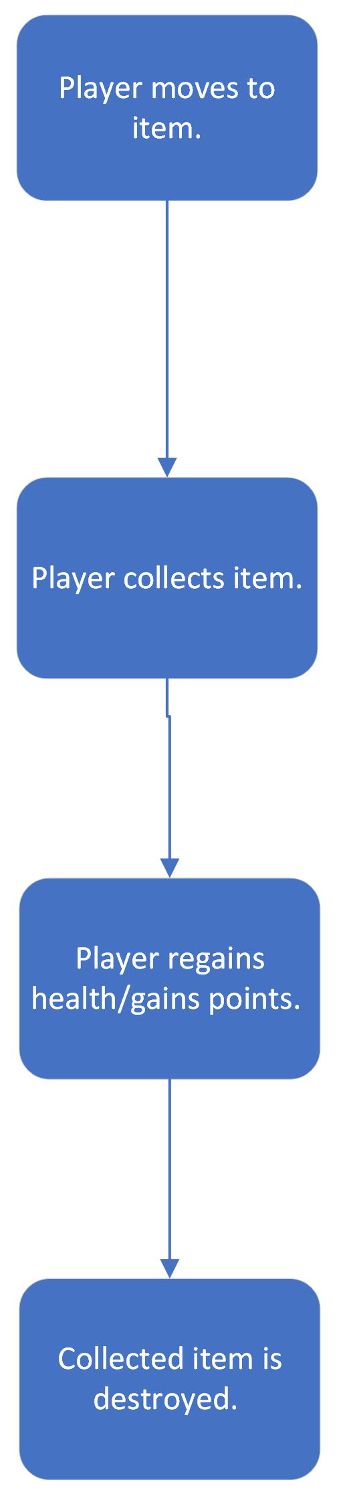
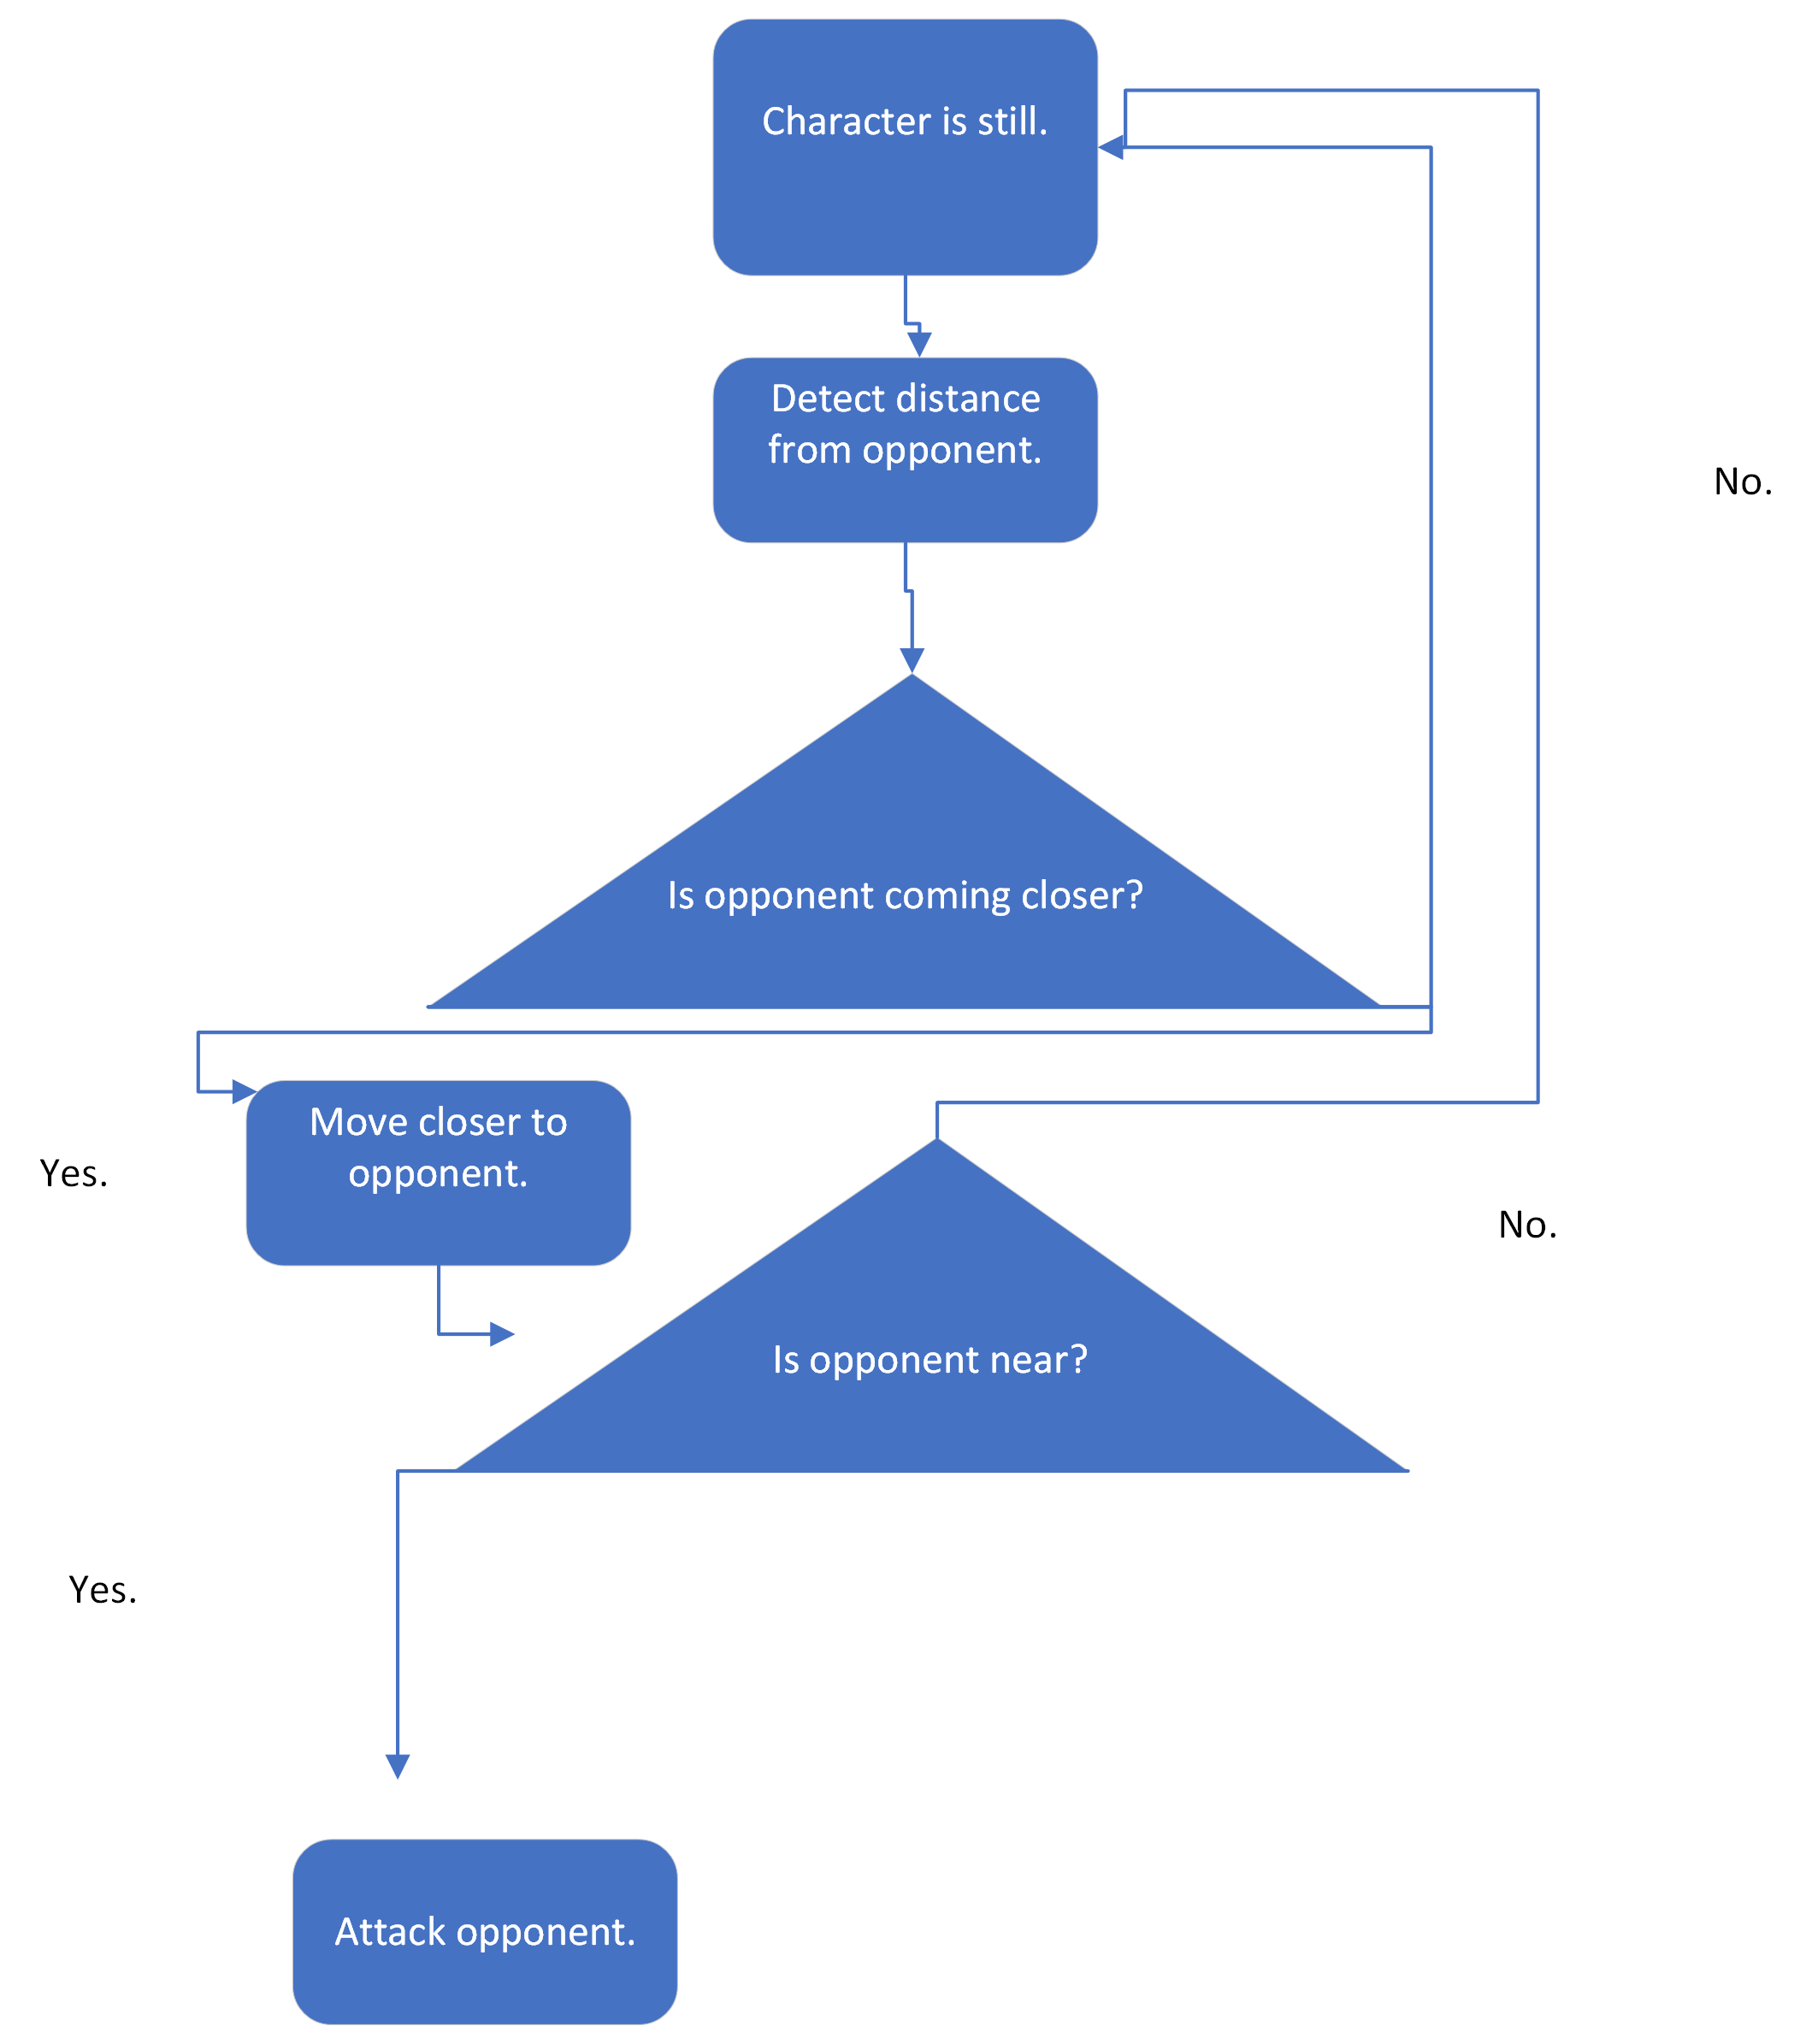
Flowcharts.

